Slide 1
Using Piecewise Support Vector Quantile Regression
Automatic Change-Point Detection
Speaker: Sheng-Yu Tsai (Justin)
National Chi Nan University
Authors: Jing-Rung Yu¹, Sheng-Yu Tsai¹, Chun-Yen Tsai¹, Donald Lien²

Slide 2
Pattern Change Detection (PCD)

Slide 3
PCD Methods
Parametric approaches
The performance of all methods depends on the dataset’s characteristics
Non-parametric approaches
Hybrid approaches
Gupta, M., Wadhvani, R., & Rasool, A. (2024). Comprehensive analysis of change-point dynamics detection in time series data: A review. Expert Systems with Applications, 123342.

Slide 4
PCD Methods
Parametric approaches
Non-parametric approaches
Hybrid approaches
Often outperform others!
Gupta, M., Wadhvani, R., & Rasool, A. (2024). Comprehensive analysis of change-point dynamics detection in time series data: A review. Expert Systems with Applications, 123342.

Slide 5
Key Challenges
Detecting multiple change-points
Handling high-dimensional or missing data
Processing large datasets efficiently
Uncertainty estimation is harder in non-parametric models
Gupta, M., Wadhvani, R., & Rasool, A. (2024). Comprehensive analysis of change-point dynamics detection in time series data: A review. Expert Systems with Applications, 123342.

Slide 6
Key Challenges
Detecting multiple change-points
Handling high-dimensional or missing data
Processing large datasets efficiently
Uncertainty estimation is harder in non-parametric models
Gupta, M., Wadhvani, R., & Rasool, A. (2024). Comprehensive analysis of change-point dynamics detection in time series data: A review. Expert Systems with Applications, 123342.

Slide 7
PSVQR Framework
1
2
3
Support Vector Regression
Quantile Loss Function
Piecewise Linear Model

Slide 8
PSVQR Framework
Multiple Objective Programming
Support Vector Regression
Quantile Loss Function
Piecewise Linear Model

Slide 9
Key Features
Multiple Objective Programming
Support Vector Regression
Quantile Loss Function
Piecewise Linear Model
Robust to Noise or Outliers
Interval Prediction
Multiple Change Point Detection

Slide 10





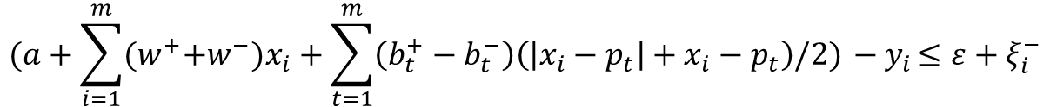

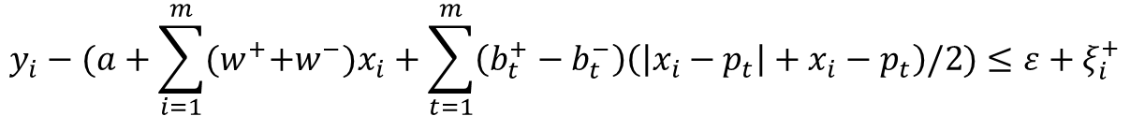

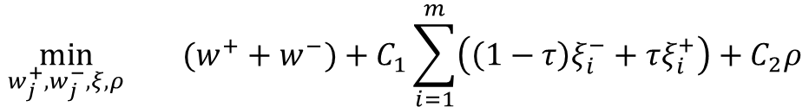


The Proposed Model
l1-norm
Quantile loss
Change Point
$$\min_{w_{j}^{+},w_{j}^{−}, ξ, ρ}{(w^{+}+w^{−})+C_{1}\sum_{i=1}^{m}{\left(\left(1−τ\right)ξ_{i}^{−}+τξ_{i}^{+}\right)}+C_{2}ρ}$$
$$y_{i}−(a+\sum_{i=1}^{m}{{{(w}^{+}+w^{−})x}_{i}}+\sum_{t=1}^{m}{\left(b_{t}^{+}−b_{t}^{−}\right)\left(\left|x_{i}−p_{t}\right|+x_{i}−p_{t}\right)\text{/2}})≤ε+ξ_{i}^{+}$$
$$s.t.$$
Piecewise Terms
$$(a+\sum_{i=1}^{m}{{{(w}^{+}+w^{−})x}_{i}}+\sum_{t=1}^{m}{\left(b_{t}^{+}−b_{t}^{−}\right)\left(\left|x_{i}−p_{t}\right|+x_{i}−p_{t}\right)\text{/2}}){ − y}_{i}≤ε+ξ_{i}^{−}$$
$w$: the hyperplane weight vector
$a$: intercept term
$m$: the size of sliding window
$ρ$: numbers of change points of $x_{i}$
$ε$: the $ε$-insensitive tube width
$b_{t}$: coefficient of change $p_{t}$
$C_{1},C_{2}$: the penalties
$ξ_{i}$: residuals outside the $ε$-insensitive tube

Slide 11
Experiment Design
Dataset: S&P 500 From 2024/07/18 to 2025/07/22
Input data
1~256
257
MAPE
PSVQR
train
test
train
test
RMSE
Z-score Standardization
ARIMA
train
test
64~319
320
NSE
Data
Model
One-Step Ahead
Measurement
Feature:
sequential index
vix
Prediction y:
price

Slide 12
Experiment Results
Model | MAPE | RMSE | NSE
ARIMA | 0.6023 | 0.1815 | 0.8093
PSVQR tau 0.1 | 1.9936 | 0.3265 | 0.5620
PSVQR tau 0.3 | 0.8064 | 0.2530 | 0.7098
PSVQR tau 0.5 | 1.7960 | 0.2454 | 0.7255
PSVQR tau 0.7 | 0.4981 | 0.2524 | 0.7300
PSVQR tau 0.9 | 0.4769 | 0.3039 | 0.8183
PSVQR tau 0.5 | 0.9267 | 0.1520 | 0.8786
benchmark
1 feature
2 features

Slide 13
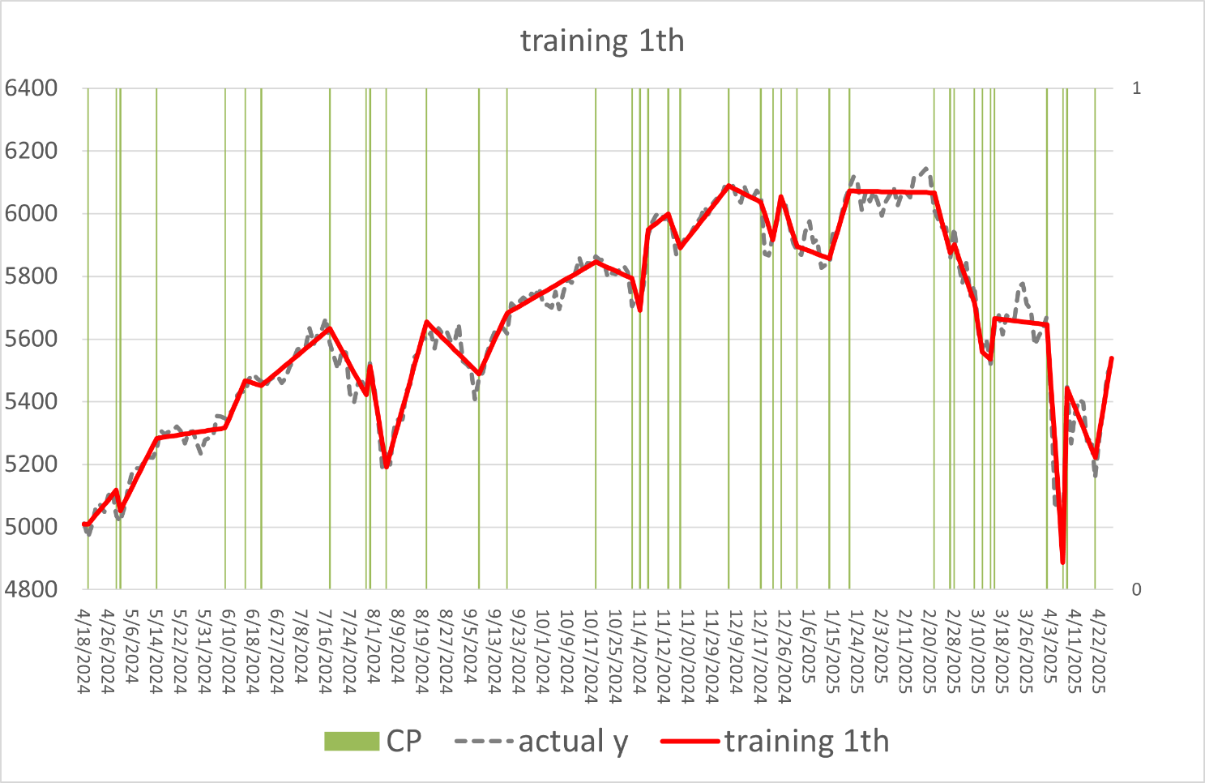
Experiment Results
Use 1 feature:
index

Slide 14
Experiment Results
Use 1 feature:
index

Slide 15
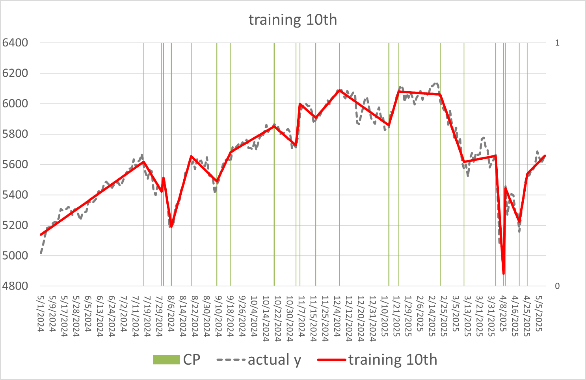
Experiment Results
Use 1 feature:
index

Slide 16
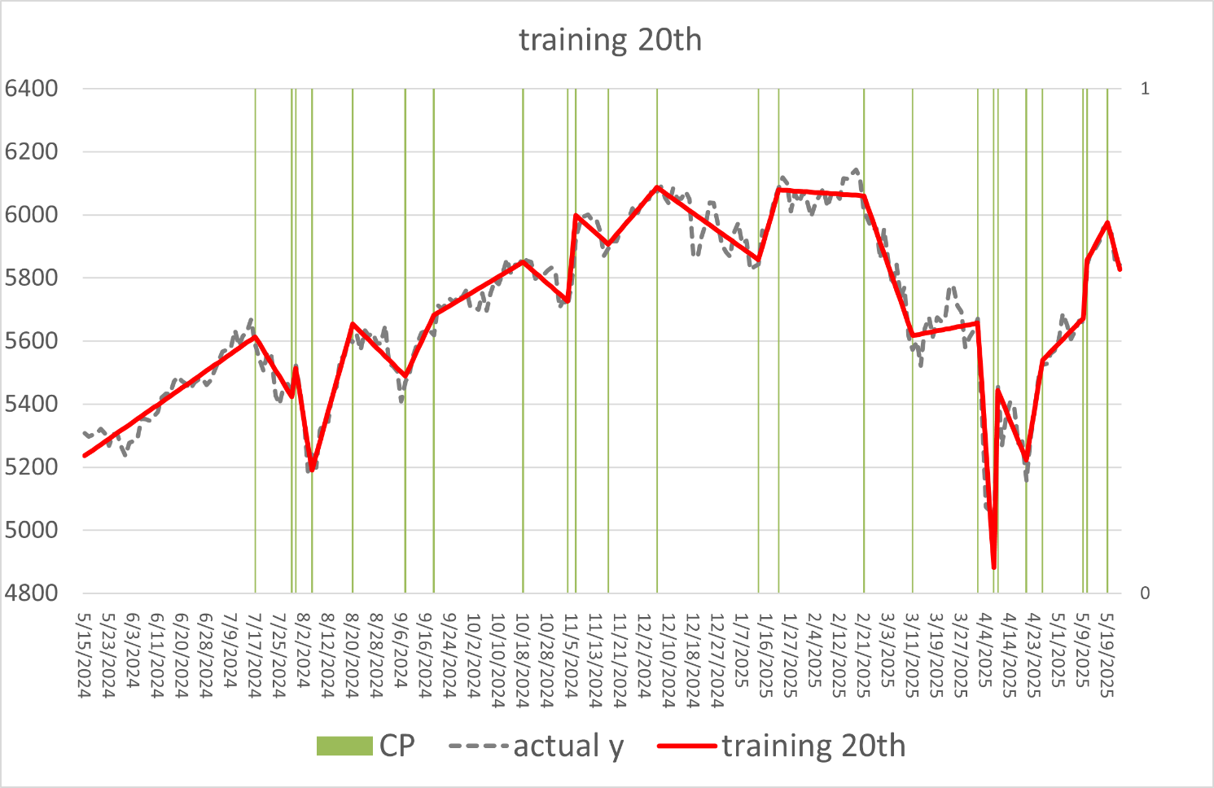
Experiment Results
Use 1 feature:
index

Slide 17
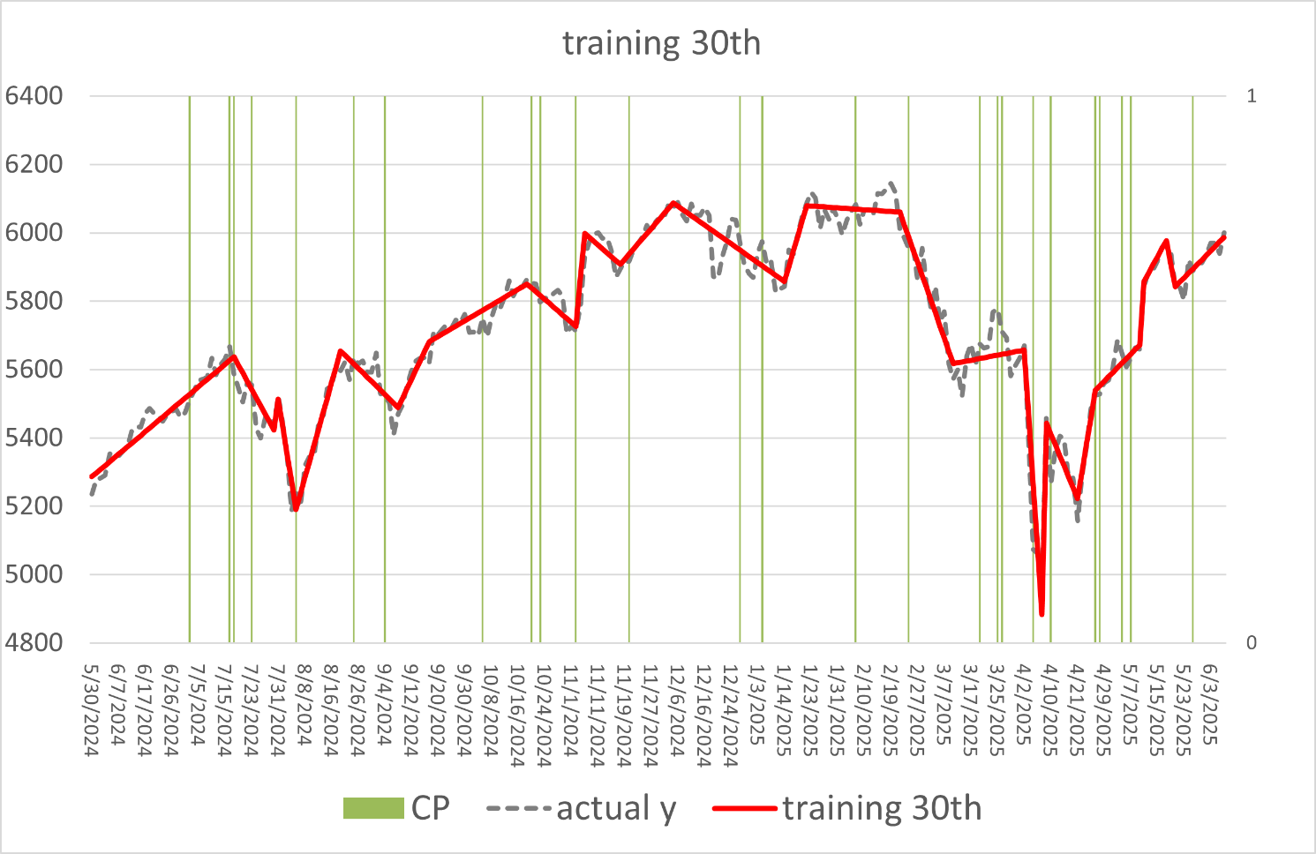
Experiment Results
Use 1 feature:
index

Slide 18
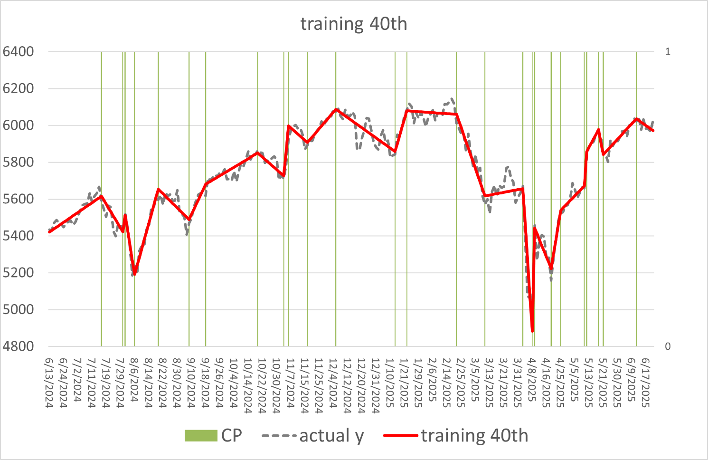
Experiment Results
Use 1 feature:
index

Slide 19
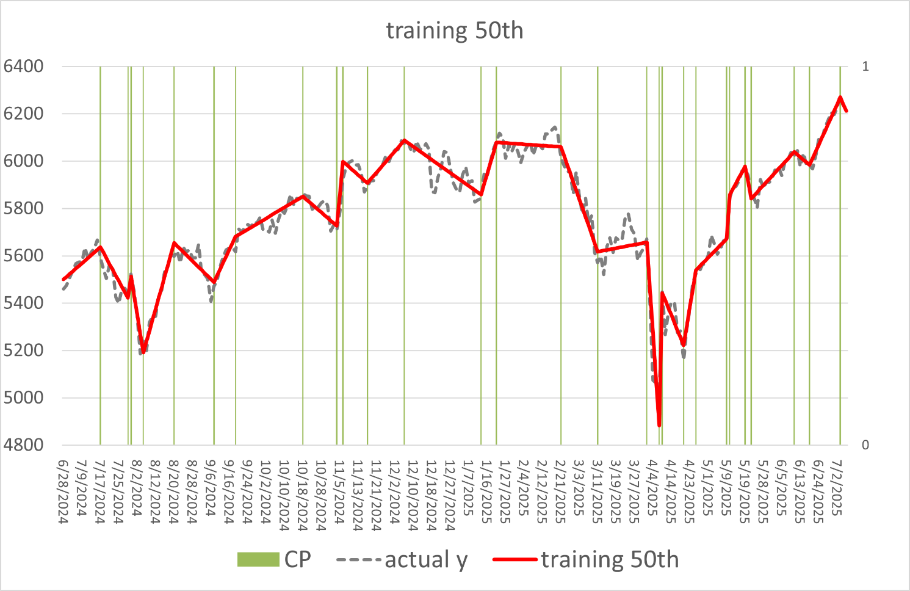
Experiment Results
Use 1 feature:
index

Slide 20
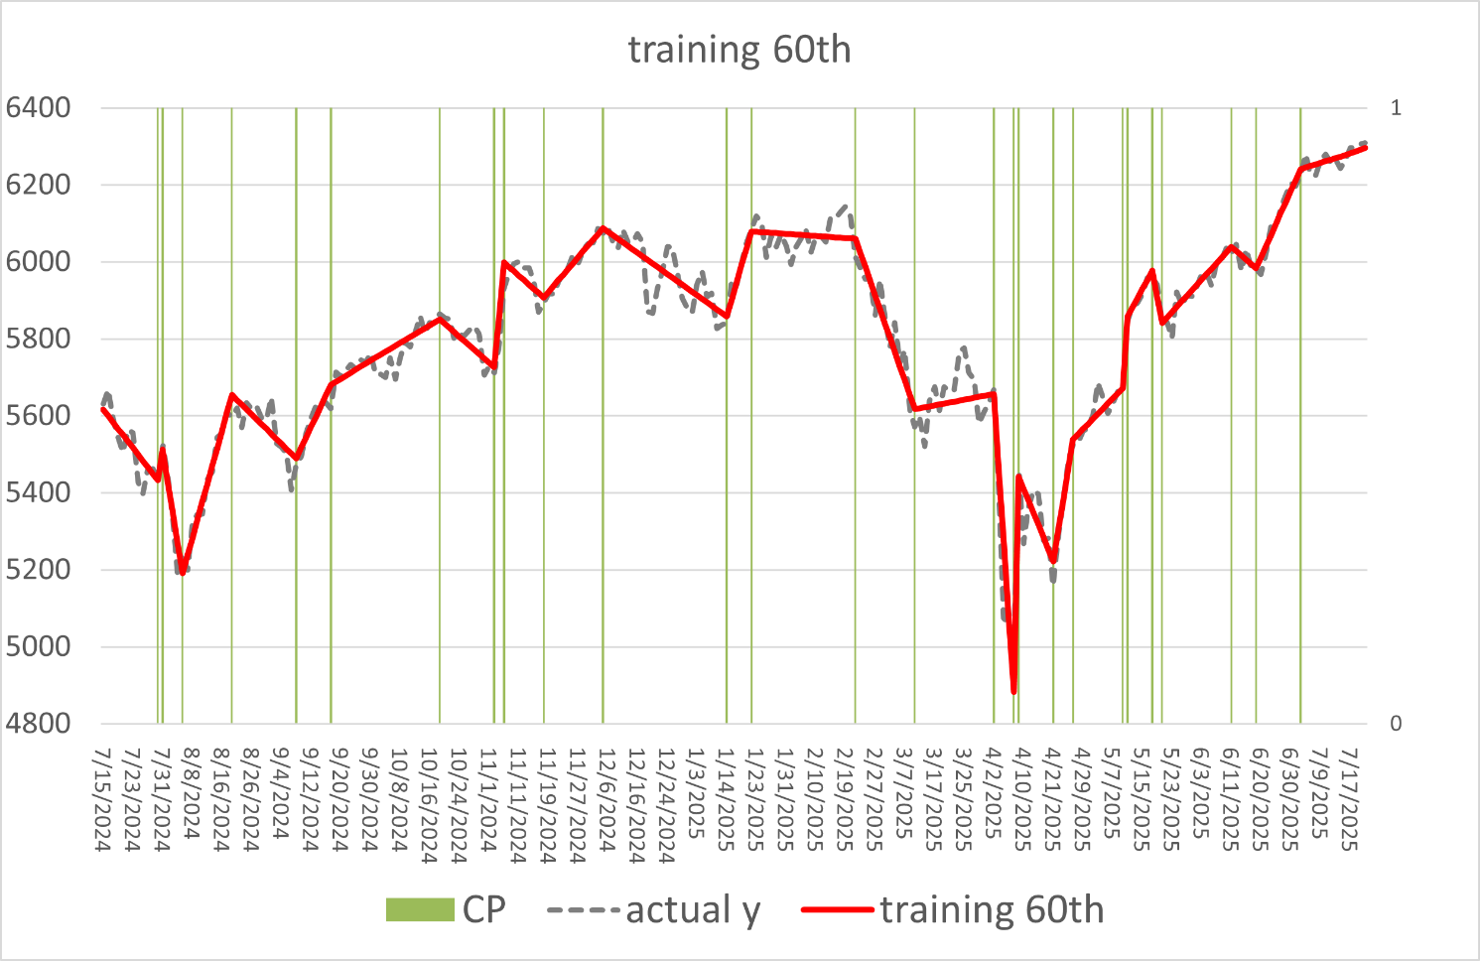
Experiment Results
Use 1 feature:
index

Slide 21
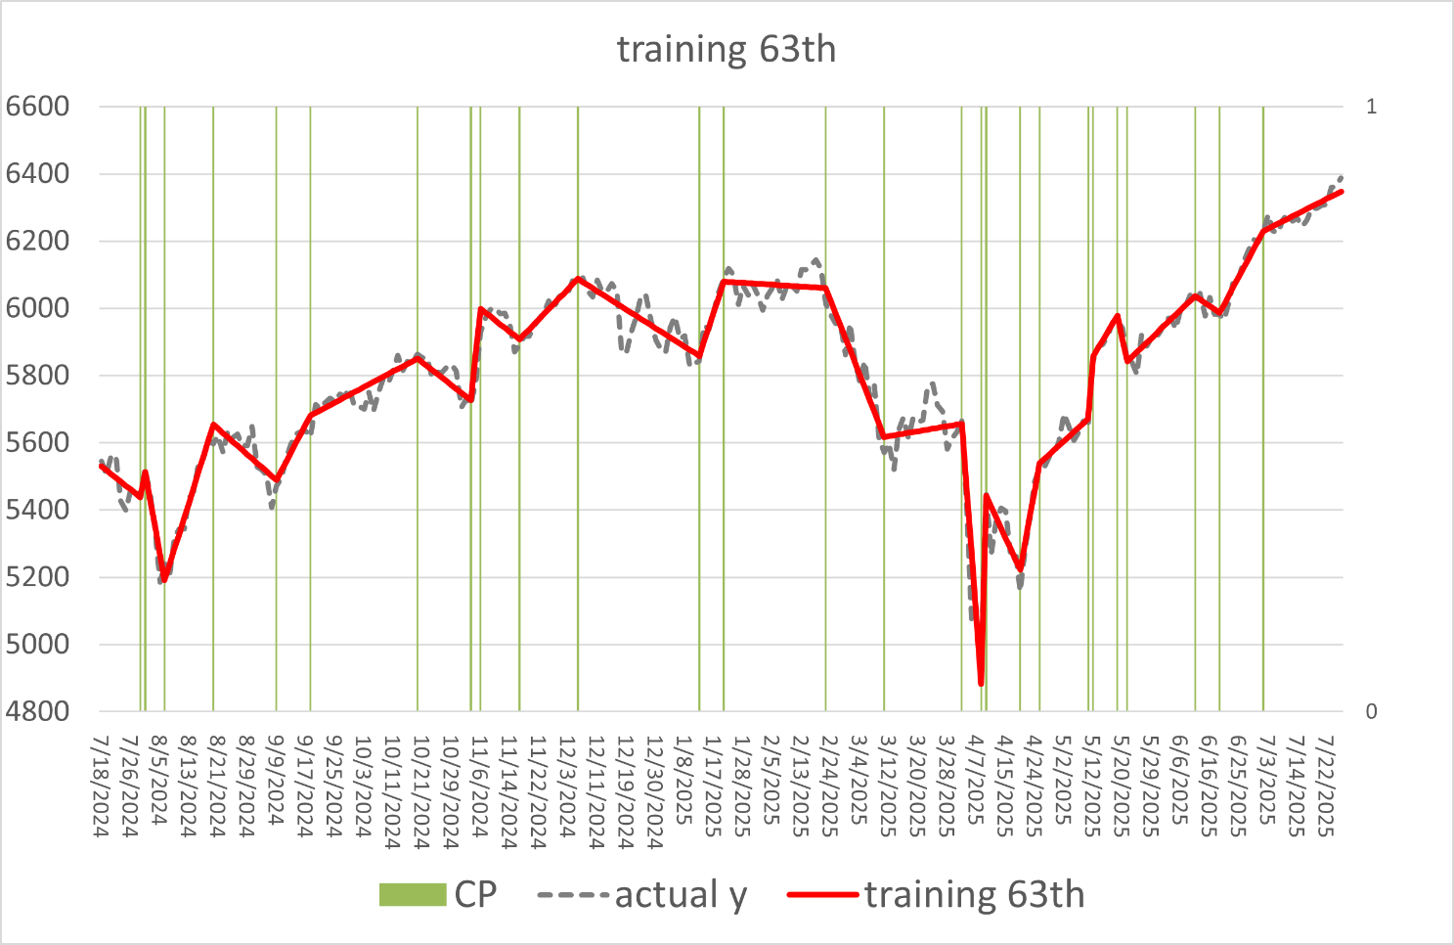
Experiment Results
Use 1 feature:
index

Slide 22
Experiment Results
Use 2 features:
index
vix

Slide 23
Experiment Results
Use 2 features:
index
vix

Slide 24
Experiment Results
Use 2 features:
index
vix

Slide 25
Experiment Results
Use 2 features:
index
vix

Slide 26
Experiment Results
Use 2 features:
index
vix

Slide 27
Experiment Results
Use 2 features:
index
vix

Slide 28
Experiment Results
Use 2 features:
index
vix

Slide 29
Experiment Results
Use 2 features:
index
vix

Slide 30
Experiment Results
Use 2 features
Use 2 features

Slide 31
Experiment Results

Slide 32
Conclusion
PSVQR with features index and vix outperforms ARIMA model.
PSVQR with features index and vix Great prediction on some change point.
Feature 1 is better at CPD, while feature 2 is better at prediction

Slide 33
Future Work
Find a proper method to decide the penalty of CP amounts.
Improve multiple feature CPD.
Transfer CPU-based solver to GPU solutions.
Compare to other PCD method witch with prediction function.

Slide 34
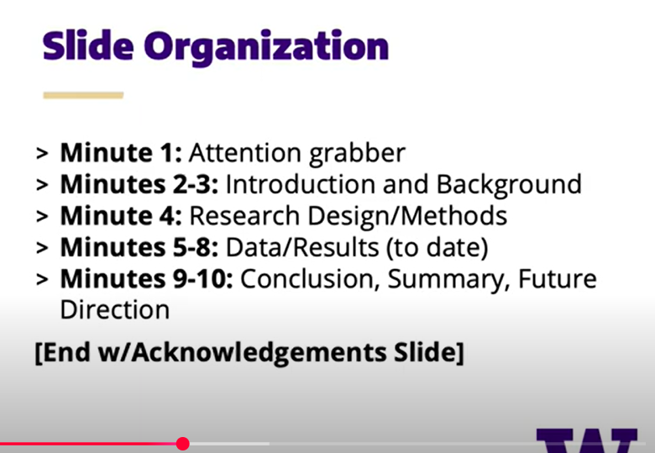

Slide 35
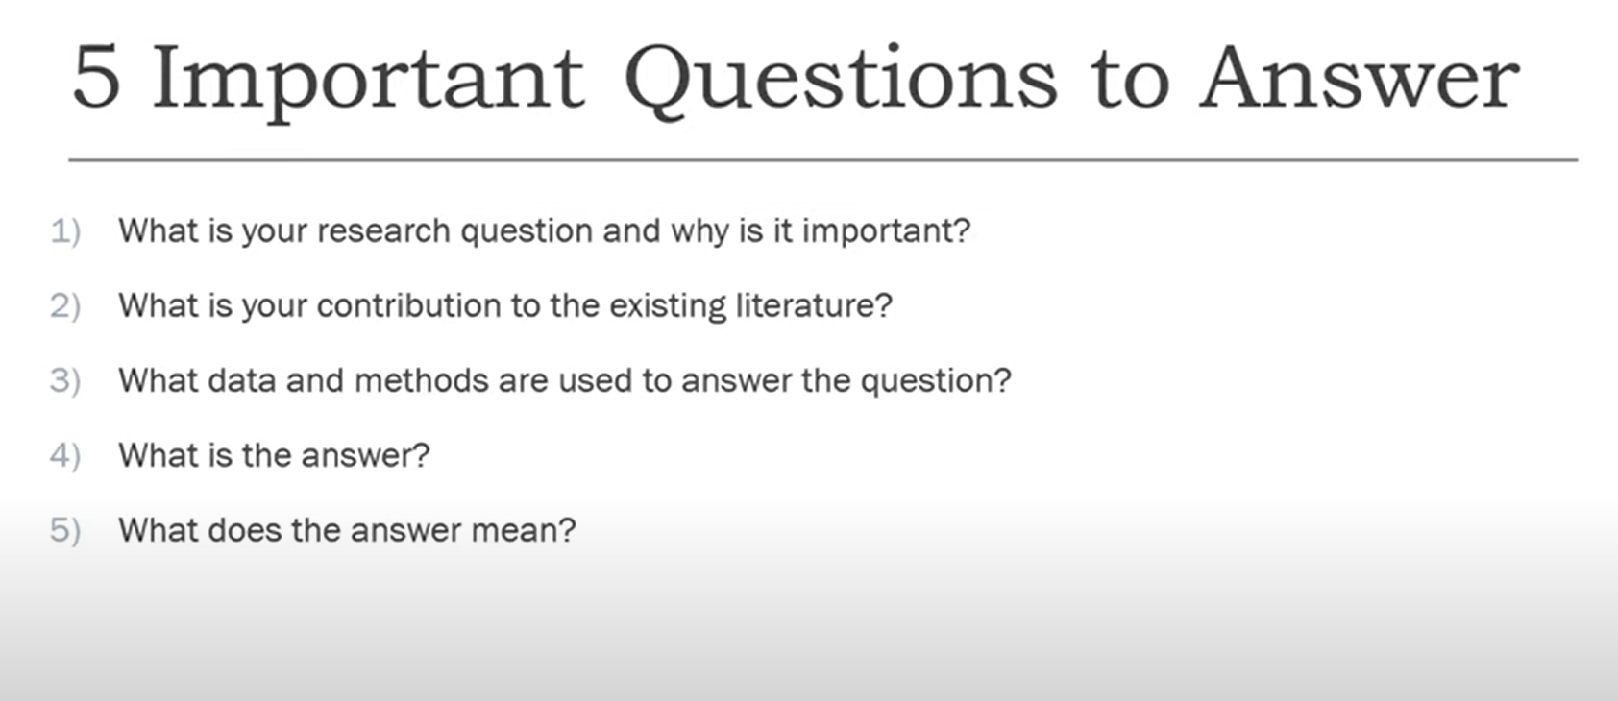

Slide 36
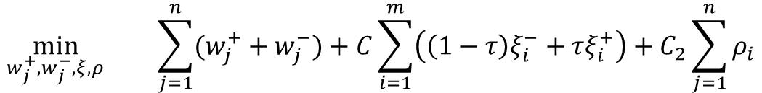

The Proposed Model
$$\min_{w_{j}^{+},w_{j}^{−}, ξ, ρ}{\sum_{j=1}^{n}{(w_{j}^{+}+w_{j}^{−})}+C\sum_{i=1}^{m}{\left(\left(1−τ\right)ξ_{i}^{−}+τξ_{i}^{+}\right)}+C_{2}\sum_{j=1}^{n}{ρ_{i}}}$$
$$y_{i}−(a+\sum_{j=1}^{n}{\left(w_{j}^{+}−w_{j}^{−}\right)x_{ij}+}\sum_{j=1}^{n}{\sum_{t=1}^{m}{\left(b_{jt}^{+}−b_{jt}^{−}\right)\left(\left|x_{ij}−p_{jt}\right|+x_{ij}−p_{jt}\right)\text{/2})}≤ε+ξ_{i}^{+}}$$
$$s.t.$$
$$(a+\sum_{j=1}^{n}{\left(w_{j}^{+}−w_{j}^{−}\right)x_{ij}+}\sum_{j=1}^{n}{\sum_{t=1}^{m}{\left(b_{jt}^{+}−b_{jt}^{−}\right)\left(\left|x_{ij}−p_{jt}\right|+x_{ij}−p_{jt}\right)\text{/2}})−y_{i}≤ε+ξ_{i}^{−}}$$

Slide 37
Why Quantile loss?
provides interval predictions by varying τ,
suitable for addressing uncertainty
effectively captures data heterogeneity
improves resilience to outliers.

Slide 38
propose a hybrid optimization approach for
automatic change-point detection and interval prediction.
Piecewise Support Vector Quantile Regression
(PSVQR)

Slide 39
Why Quantile loss?
smaller τ penalizes overestimated samples (where the true value is less than the prediction).
larger τ penalizes underestimated samples (where the true value exceeds the prediction)

Slide 40



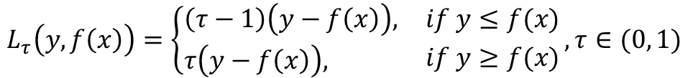
Why Quantile loss?
Absolute loss
$$L\left(y, f\left(x\right)\right)=|y−f(x)|$$
Wang, Q., Ma, Y., Zhao, K., & Tian, Y. (2020). A comprehensive survey of loss functions in machine learning. Annals of Data Science, 1-26.
Square loss
$$L\left(y, f\left(x\right)\right)={(y, f\left(x\right))}^{2}$$
Quantile loss
$$L_{τ}\left(y, f\left(x\right)\right)=\left\{\begin{aligned}&\left(τ−1\right)\left(y−f\left(x\right)\right), \\ &τ\left(y−f\left(x\right)\right),\end{aligned} {if y≤f(x) \atop if y≥f(x)},τ∈(0, 1)\right.$$
$ε$-insensitive loss
$$L_{ε}\left(y, f\left(x\right)\right)=\max{\{0, \left|y−f\left(x\right)\right|−ε\}}=\left\{\begin{aligned}&0, \\ &\left|y−f\left(x\right)\right|−ε,\end{aligned} {if \left|y−f\left(x\right)\right|≤ε \atop if \left|y−f\left(x\right)\right|>ε} ,ε>0\right.$$

Slide 41




Why Quantile loss?
Adapt Quantile loss and $ε$-insensitive loss
$$\min_{}\left(1−τ\right)ξ^{−}+τξ^{+}$$
$$(y−w^{T}x)−ε≤ξ^{+}$$
$$ε−\left(y−w^{T}x\right)≤ξ^{−}$$

